Slide 1
Occultations of the Galilean Satellites - How Accurate are the Ephemerides?
Tony Mallama
32nd Annual Meeting of IOTA
2014 July 12-13, College Park MD

Slide 2
Galilean Satellite Ephemerides
JPL JUP-series
Includes astrometry from Galileo Orbiter
IMCCE (Paris) L-series
Omits astrometry from Galileo Orbiter
JPL E-series
1990s vintage

Slide 3
Ephemeris Accuracy
Analyzed 20 years of Jovian eclipse timings
Computed observed-minus-calculated (O-C)
Searched for anomalies in O-C plots
Reference: Mallama, Stockdale, Krobusek and Nelson, 2010. Icarus, 210, 346-357

Slide 4
Io O – C

Slide 5
Io Resonance Errors

Slide 6
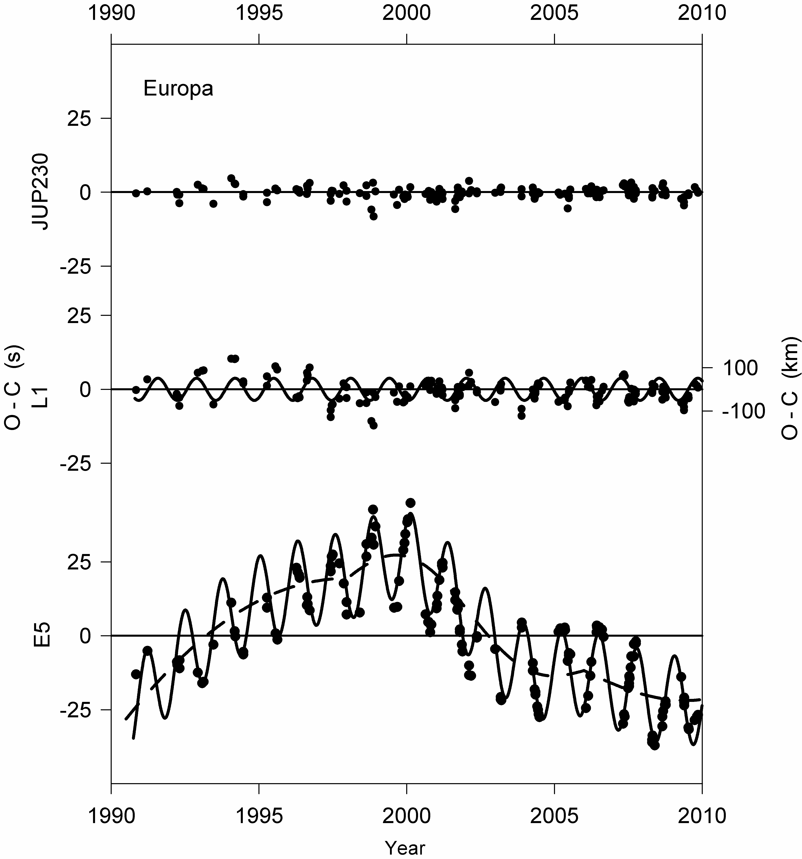
Europa O – C

Slide 7
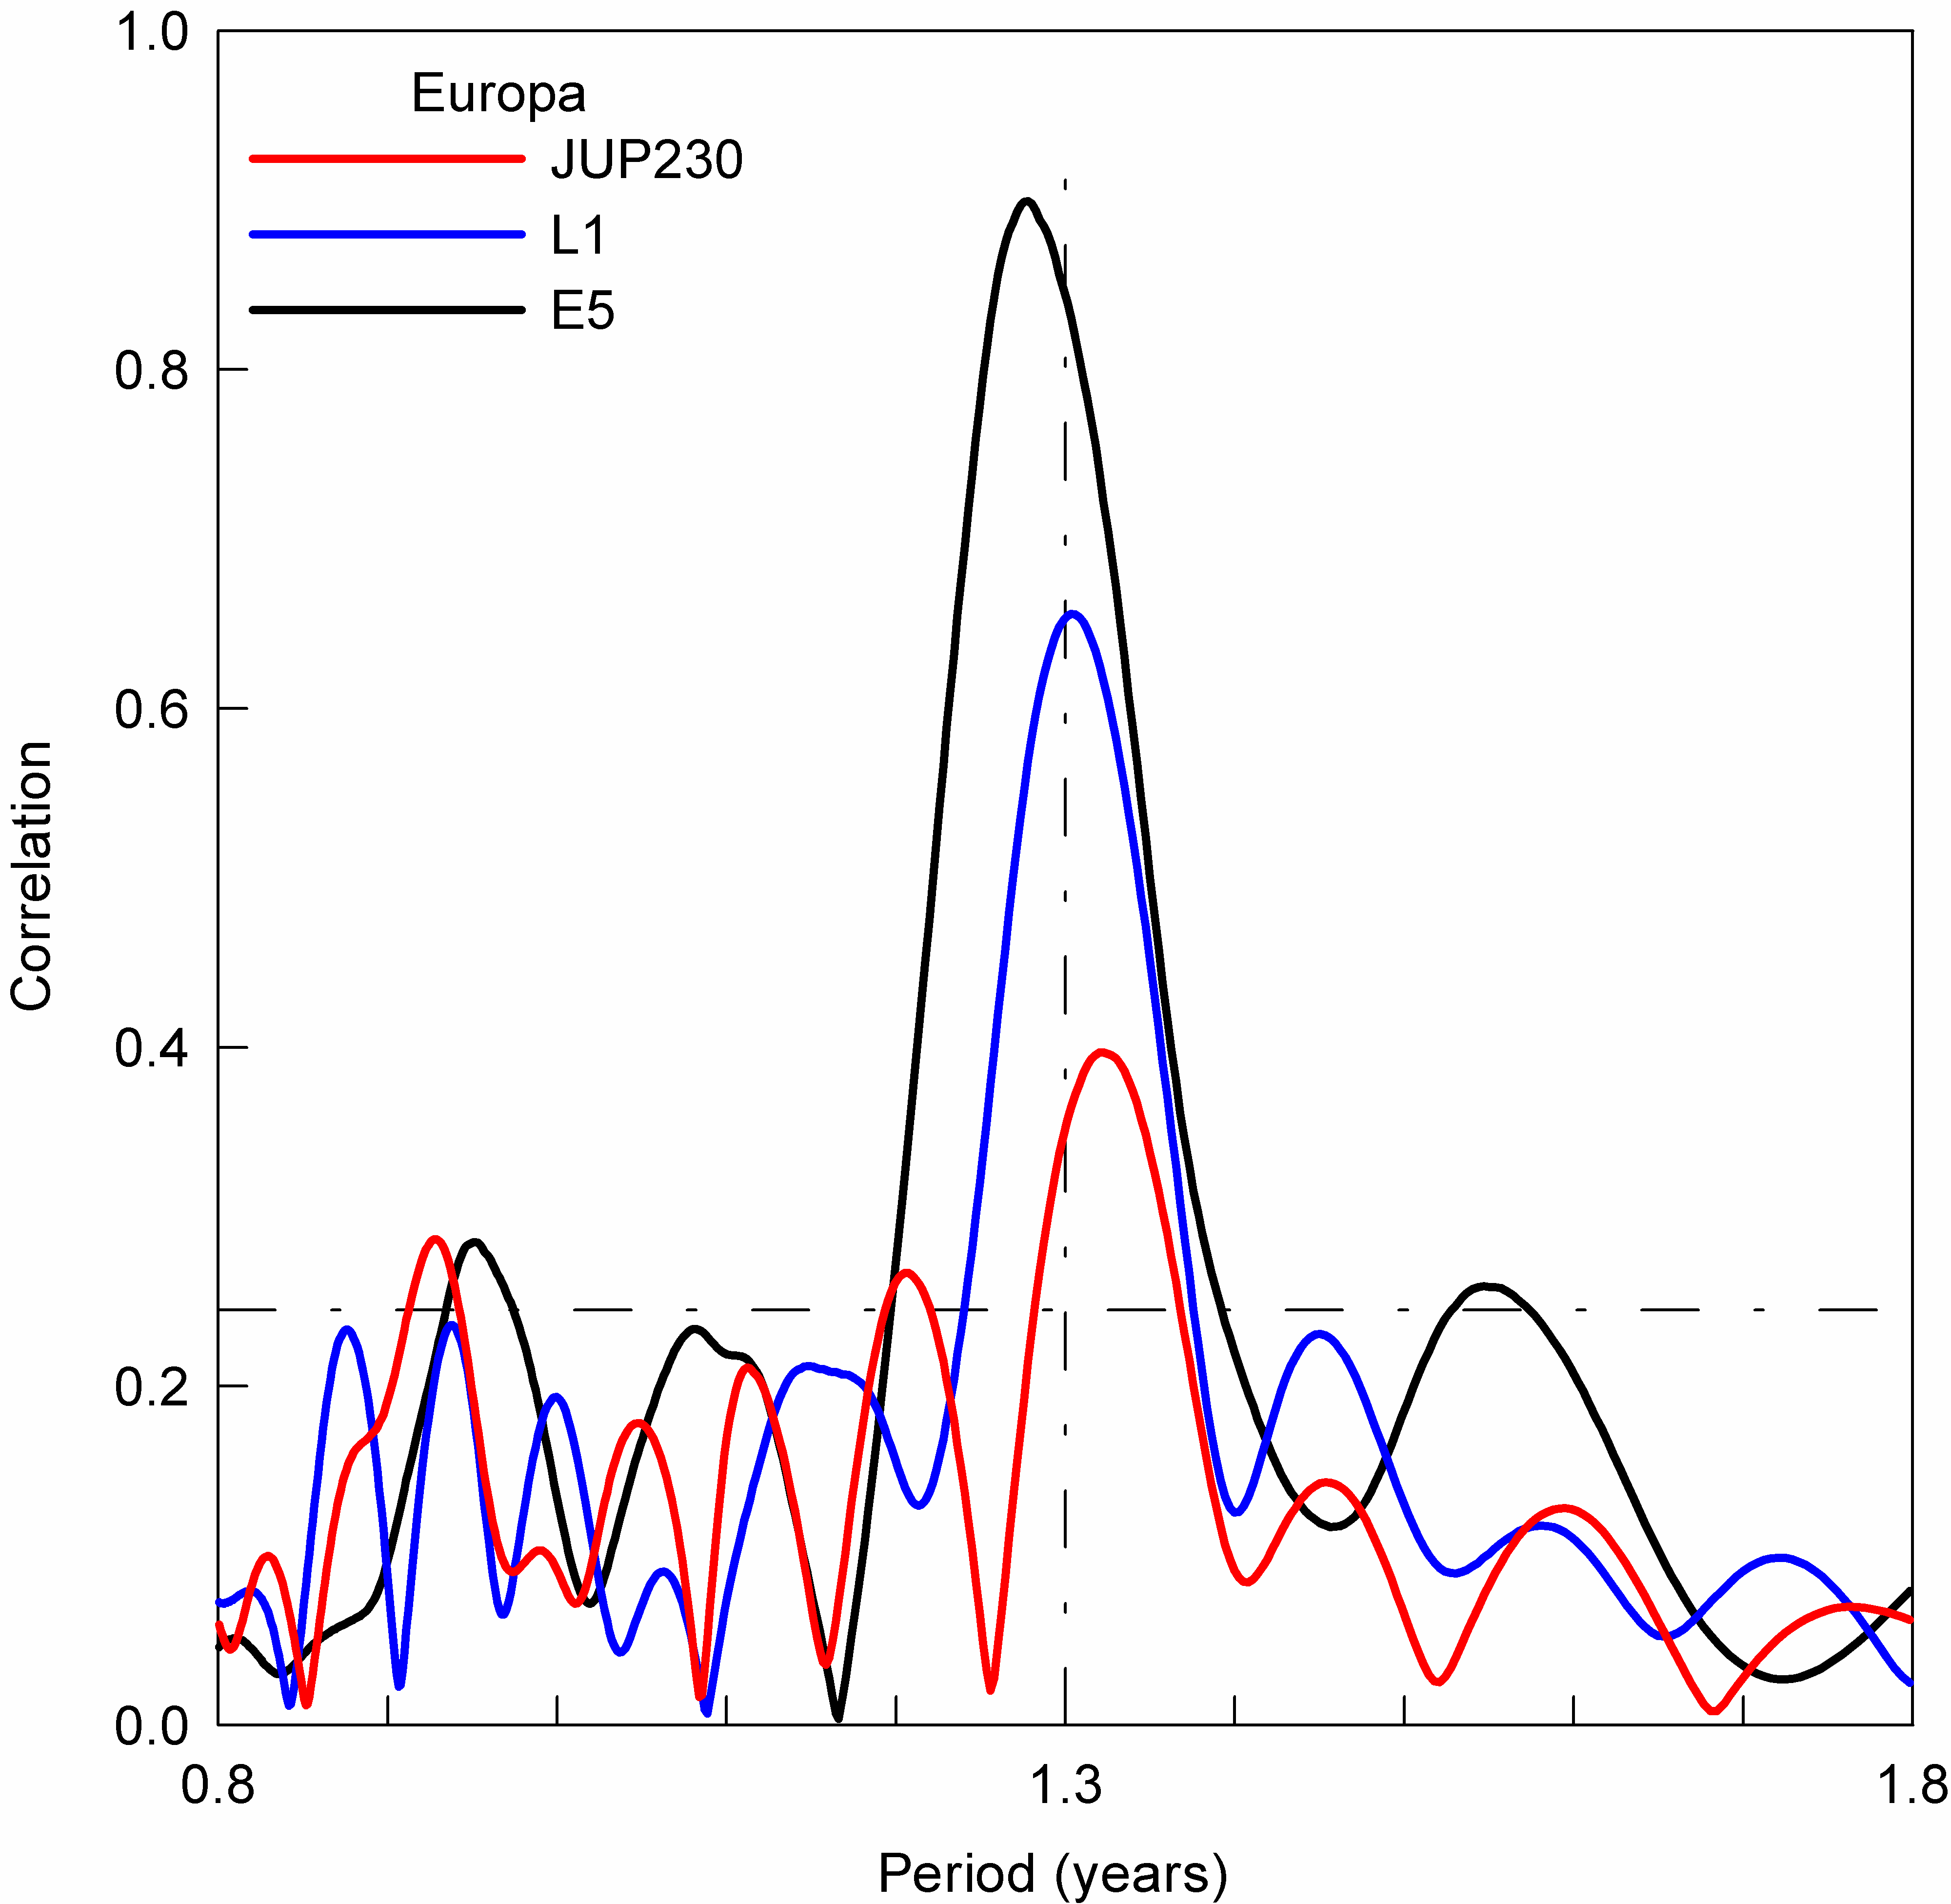
Europa Resonance Errors

Slide 8
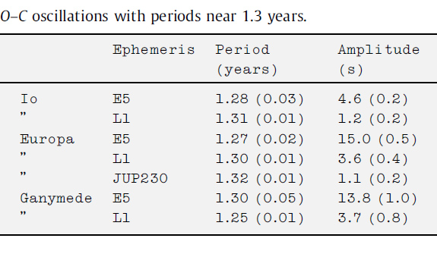
Summary of Resonance Errors

Slide 9
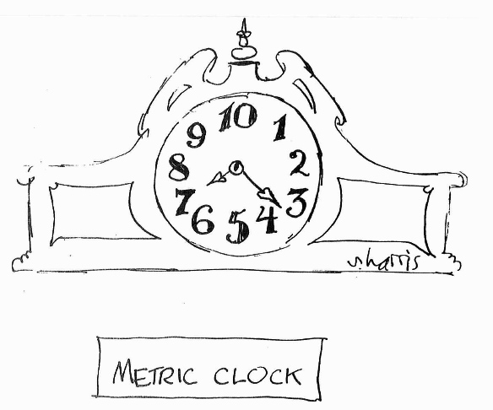

Slide 10
Astrometric Accuracy
Random Photometric Errors (scatter)
Assume that they are zero
Systematic (modeling) Errors

Slide 11
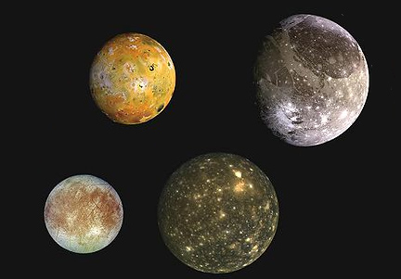
Albedo Features and Limb-Darkening

Slide 12
Photo-Center Offsets
Albedo Solar
Io 68 209
Europa 107 221
Ganymede 113 303
Callisto 93 255
Estimated maxima in kilometers
Mallama. 1993. J. Geophys. Res. 98, 18,873-18,876

Slide 13
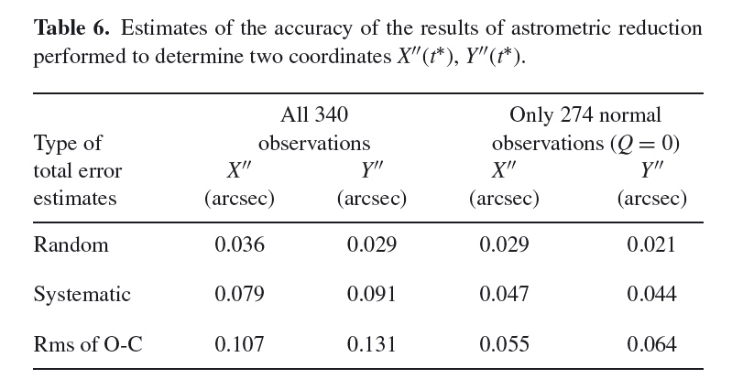
Uncertainties in Mutual Event Results Computed for PHEMU 2003
Emelyanov. 2009. MNRAS 394, 1037-1044

Slide 14
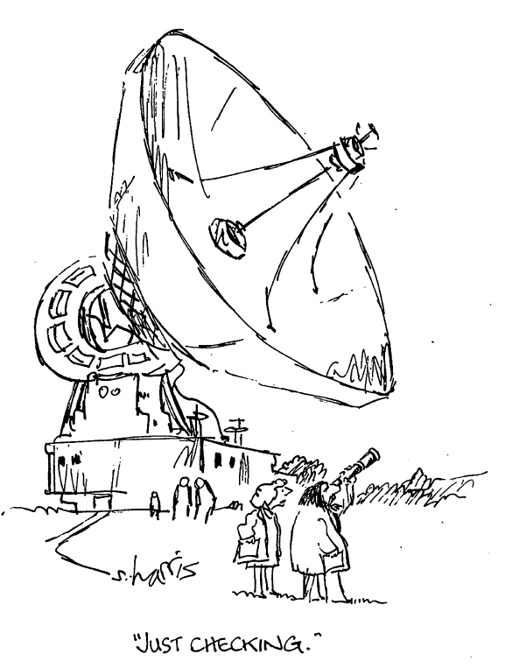

Slide 15
Comparison Between Uncertainties of Ephemerides and Astrometry
Unit conversion (for ephemeris uncertainty)
JUP230 resonance error for Europa = 1.1 s
Velocity of Europa = 13.7 km/s
1 km at Jupiter distance = 0.00026 arc second
Arc second error in JUP230 = 0.004

Slide 16
Comparison Between Uncertainties of Ephemerides and Astrometry
Worst case for JUP230 = 0.004 arc second
Best case for astrometry = 0.044 arc second
Bottom line:
JUP230 is 10x more accurate than
mutual occultation astrometry

Slide 17
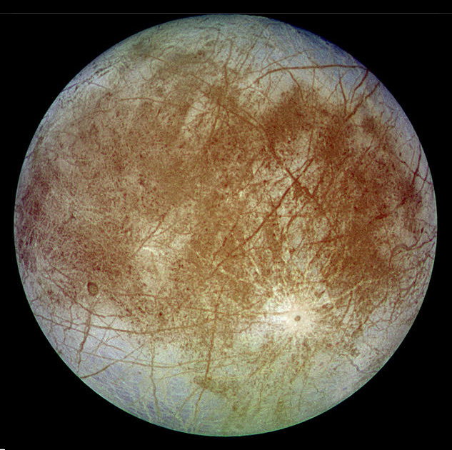
Comparison Shown Graphically

Slide 18
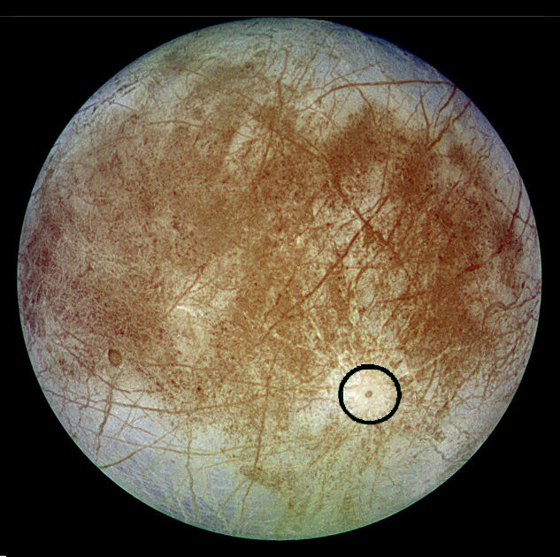
Comparison Shown Graphically

Slide 19
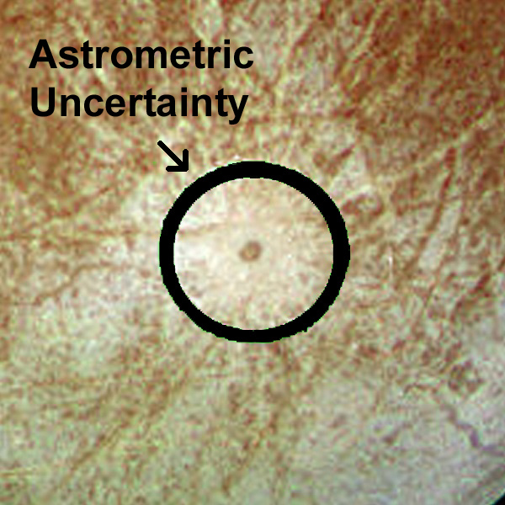
Comparison Shown Graphically

Slide 20
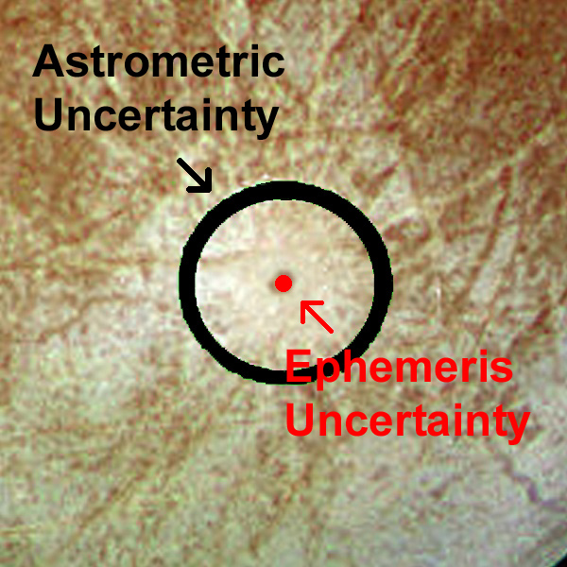
Comparison Shown Graphically

Slide 21
Summary
The current JPL ephemerides for the Galilean
satellites are much more accurate than
astrometry from mutual occultations.
However, occultation results are still being
collected and they will continue to contribute
to the development of future ephemerides.

Slide 22
Backup Slides

Slide 23
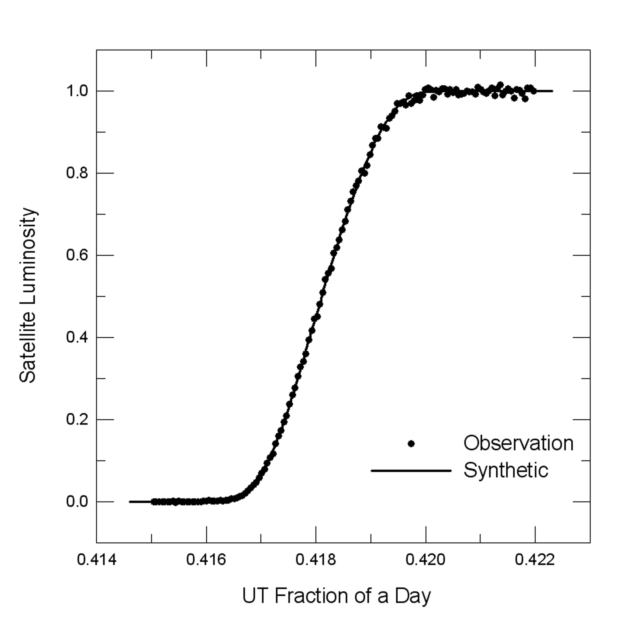
Egress from Shadow of Jupiter
Reference: Mallama, Stockdale, Krobusek and Nelson, 2010. Icarus, 210, 346-357

Slide 24
Model of Eclipse by Jupiter
Reference: Mallama, Stockdale, Krobusek and Nelson, 2010. Icarus, 210, 346-357

Slide 25
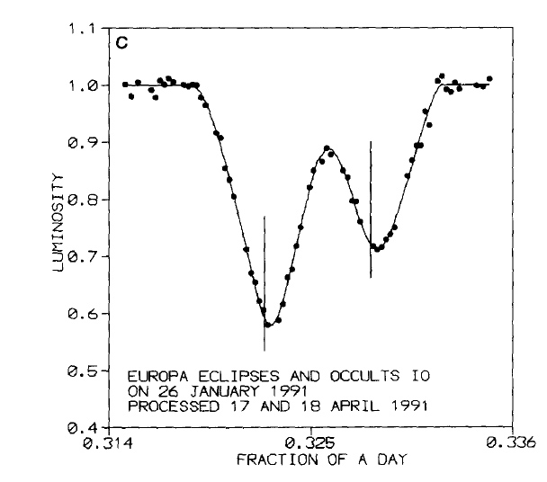
Mutual Events versus E3 Predictions
Reference: Mallama, 1992. Icarus, 95, 309-318

